Slide 1
BUILD AN EVENT MANAGEMENT SYSTEM USING SALESFORCE
Team Lead : K. HARINI
Member 1: R. BHARATHI GOWSALYA
Member 2: H.AYESHA SAMSATH
Member 3: J. HEMAVATHI

Slide 2
Introduction:
An event is a message that indicates an occurrence or change in your enterprise. Events can indicate a negative occurrence or object state change. Event management is crucial to understanding the dynamic state of an enterprise across the network, security, system, application, service, and other domains. As the number of resources grows exponentially, so do the challenges of understanding and administering diverse management events from those resources.

Slide 3
Implementing Event Management in a complex distributed environment helps organizations create a unified event management system for their enterprise, providing a holistic view of the entire IT infrastructure. The solution lets organizations collect, transform, correlate, filter, enrich, and manage events from various sources (such as network devices, applications, and enterprise servers) across the enterprise. You can track the events and can create policies to have a manageable set of actionable conditions and convert those conditions for escalation and inclusion in alert queues.

Slide 4
Purpose:
The sole purpose of any event is that a group of people will convene in one particular place for one particular purpose at a given time. Now that could be various purposes such as a wedding, a business networking function, a church gathering, etc. All of which is to come together to explore that purpose.
Event Directors need to see their events in a wider context and to understand an event may have many different "stakeholders", that is people having an interest in the event. It is worthwhile pausing to consider who are the potential stakeholders in an event and what are their needs.

Slide 5
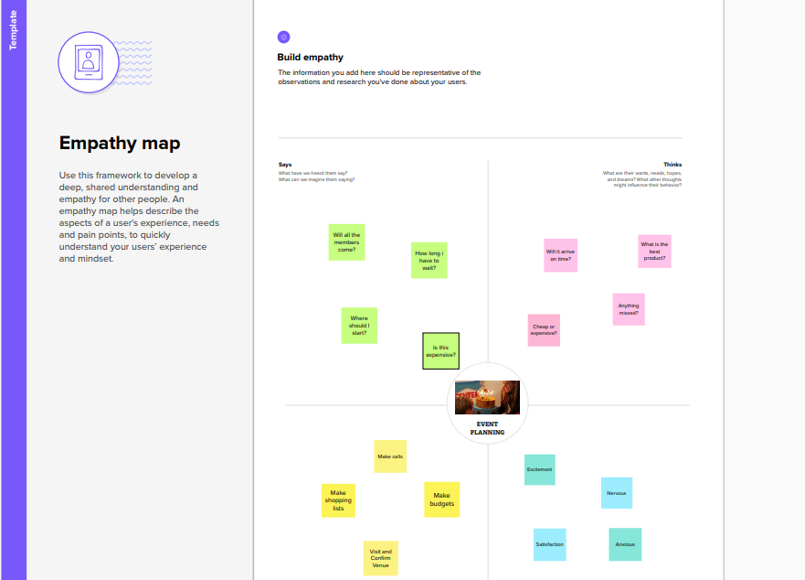
Empathy map:

Slide 6
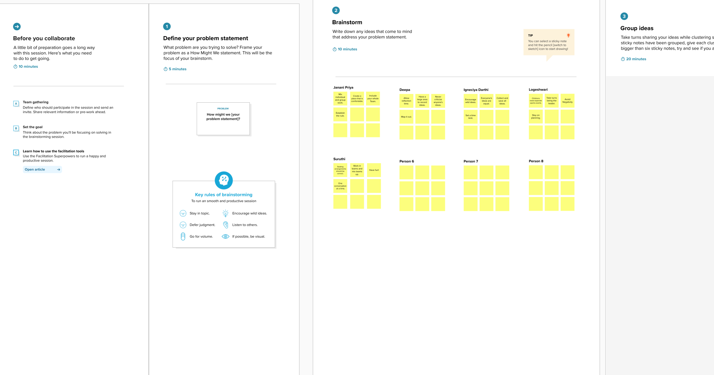
Ideation and Brainstorming map:

Slide 7
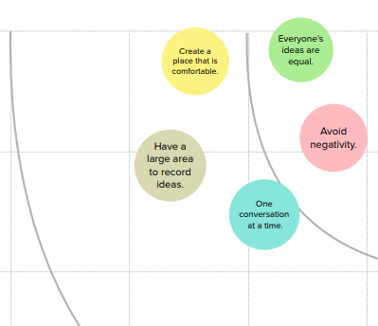

Slide 8
Data model:
Object name | Fields in the Object
EVENT | Field label | Data type
 | City | Text
 | Start Date | Date/ Time
 | End Date | Date/Time
 | Event Name | Master –Detail relationship
 | Event Name | Look-up relationship
ATTENDEE | Field label | Data type
 | ID | Auto number
 | Phone | Phone
 | Email | Email
SPEAKER | Field label | Data type
 | Bio | Text Area
 | e-mail | Email
VENDOR | Field label | Data type
 | e-mail | Email
 | Phone | phone
 | Service provider | Text

Slide 9
Milestone 1: Creating a
salesforce Developer Org

Slide 10
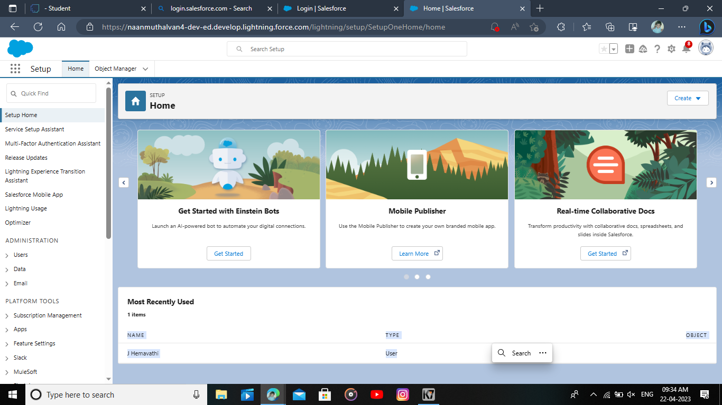
Milestone 1:Creating a salesforce developer org
A Developer org has all the features and licenses you need to get started with salesforce.

Slide 11
Milestone 2 : Object

Slide 12
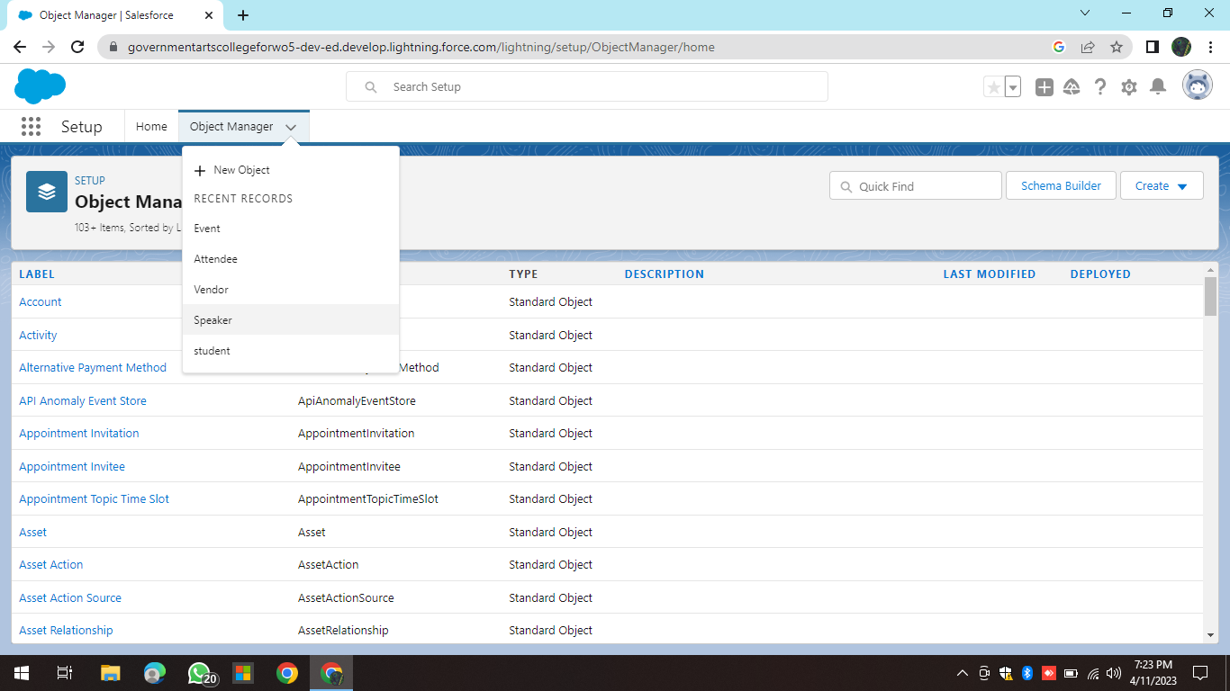
Milestone 2:Object
For this event management we need to create 4 objects i.e, Events, Attendees ,Speakers and Vendors.

Slide 13
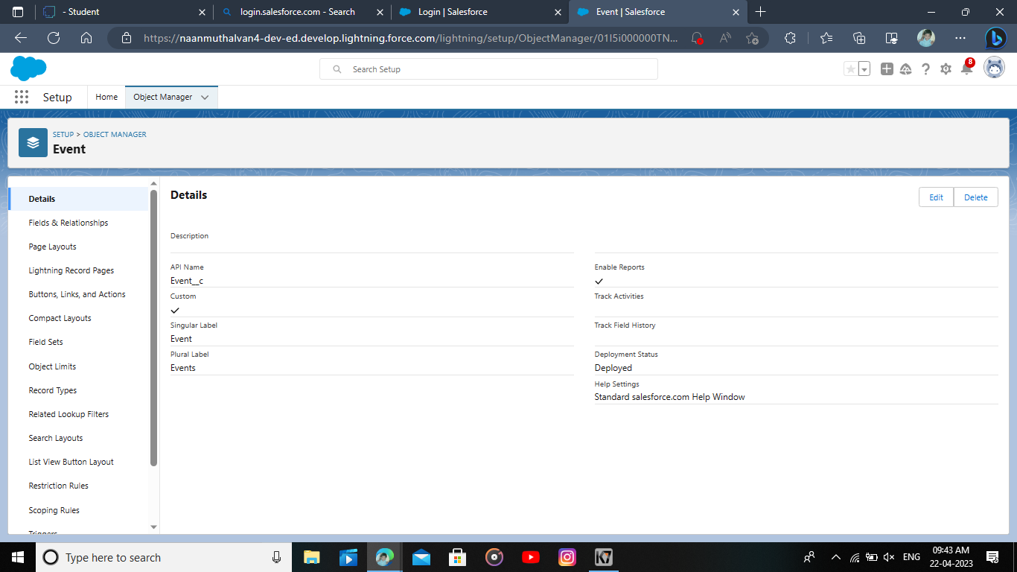

Slide 14
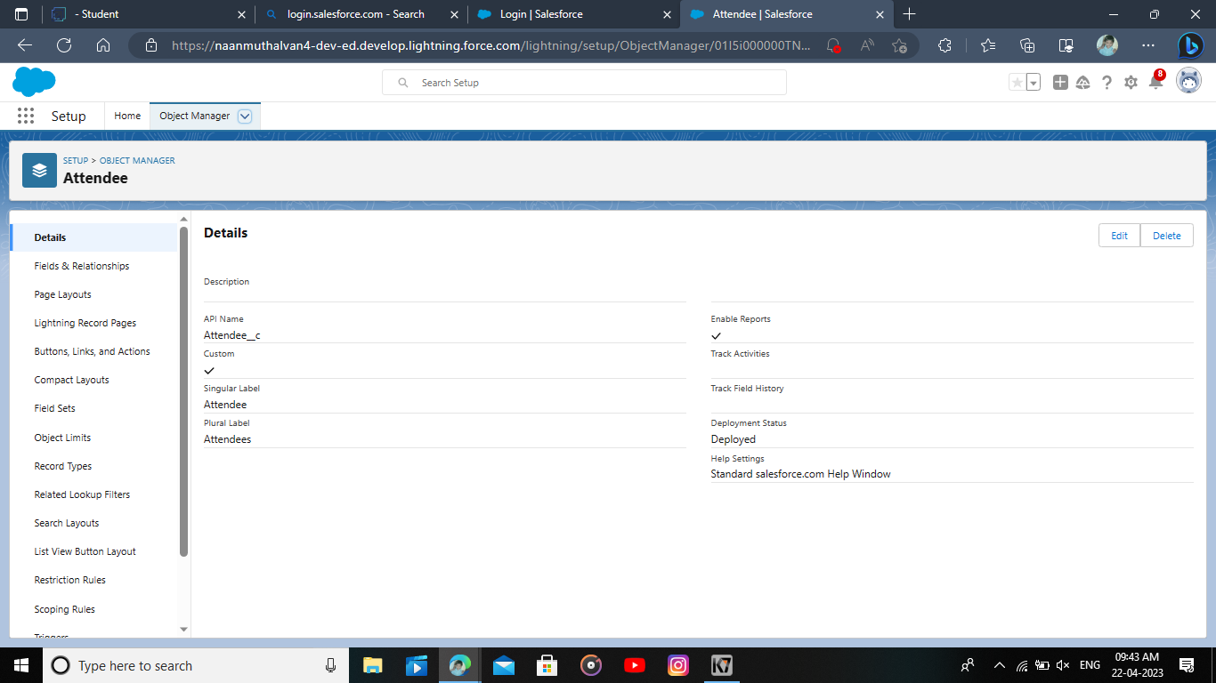

Slide 15


Slide 16


Slide 17
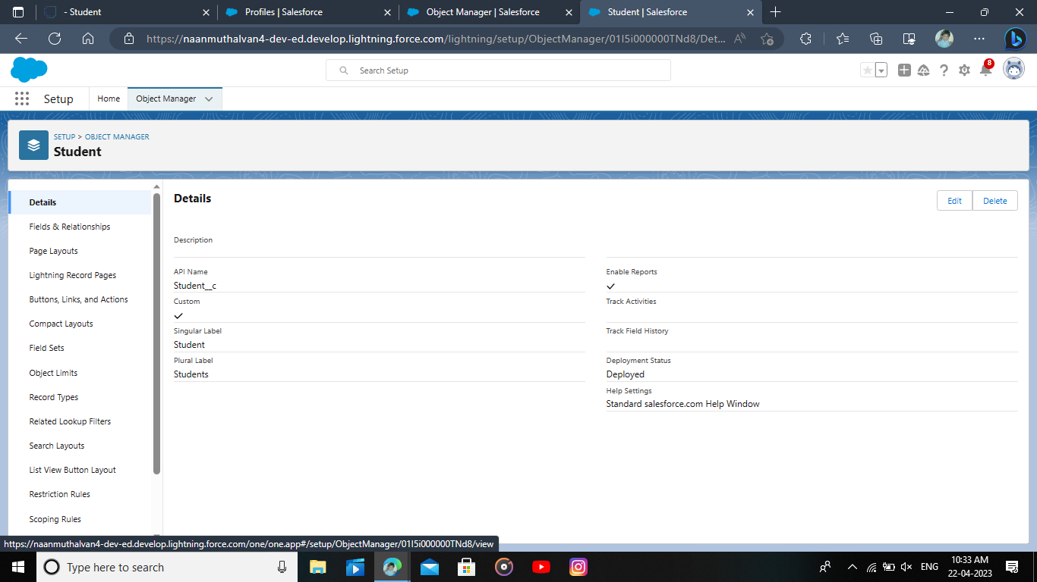

Slide 18
Milestone 3 : Tabs & Application

Slide 19
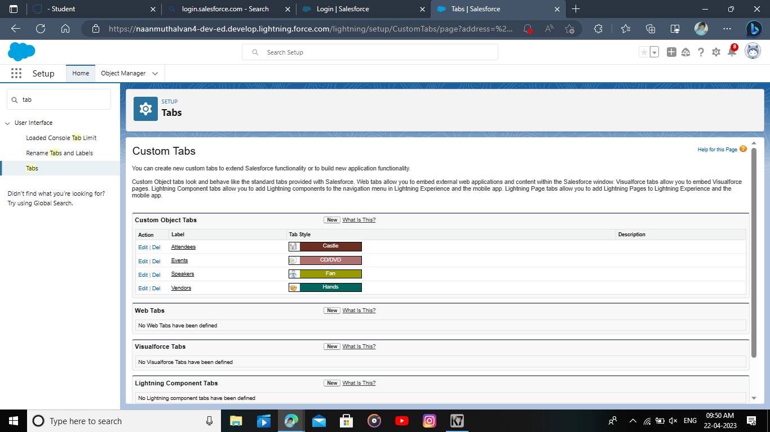
Milestone 3:
Tabs in salesforce help users view the information at a glance. It displays the data of object and other web content in the application.

Slide 20
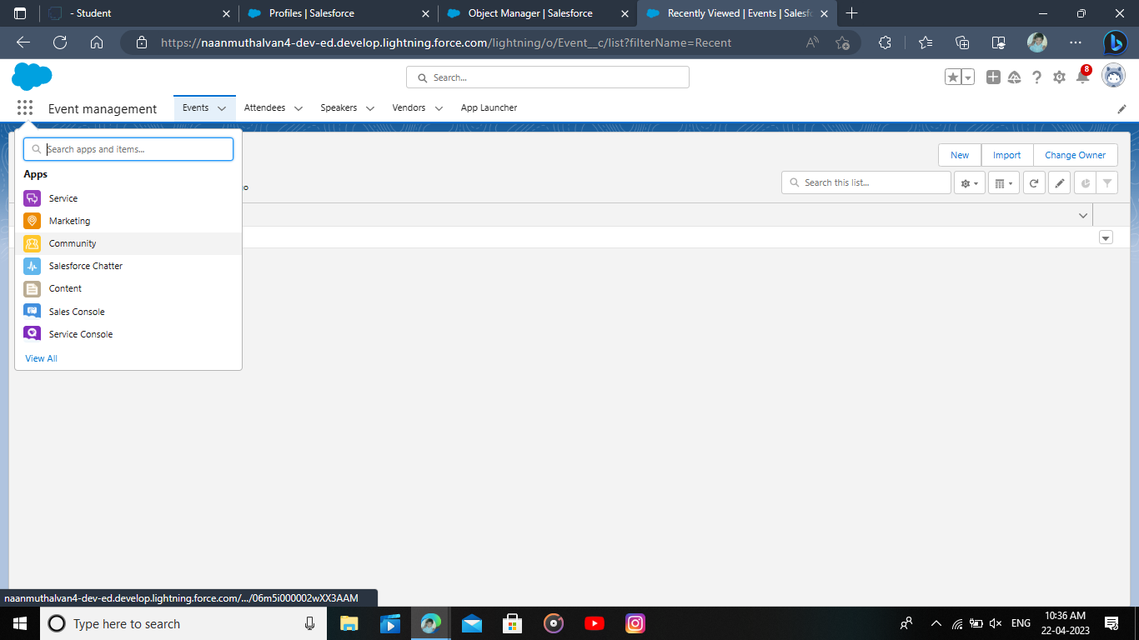
Application:
Apps in salesforce are a group of tabs that help the application function by working together as a unit. It has a name, a logo, and a particular set of tabs.

Slide 21
Milestone 4 : Fields

Slide 22
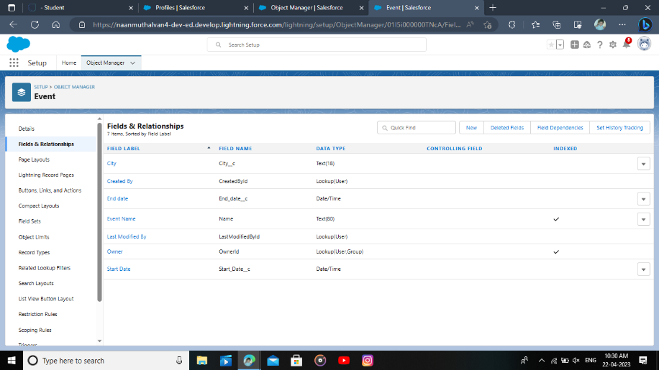
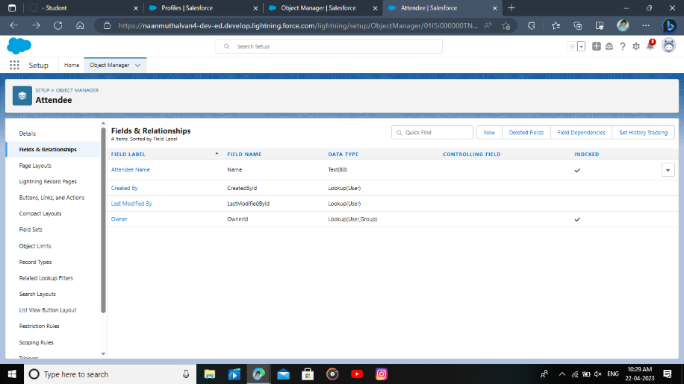
Fields:
Field : Event
Field : Attendee

Slide 23
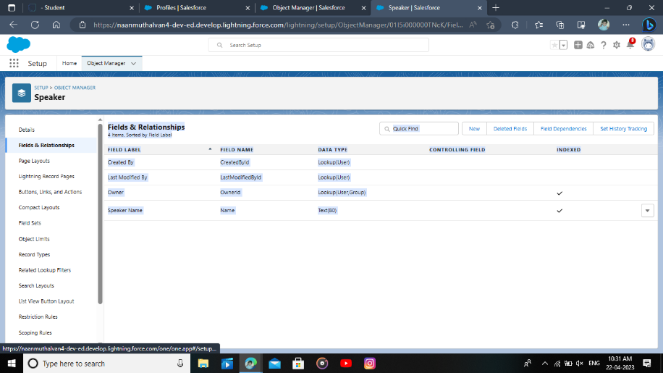

Field :Vendor
Field : Speaker
Field :Vendor
Fields in salesforce represents what the columns represents in relational databases. it can store data values which are required for a particular object in a record.

Slide 24
Milestone 5 : Profile

Slide 25
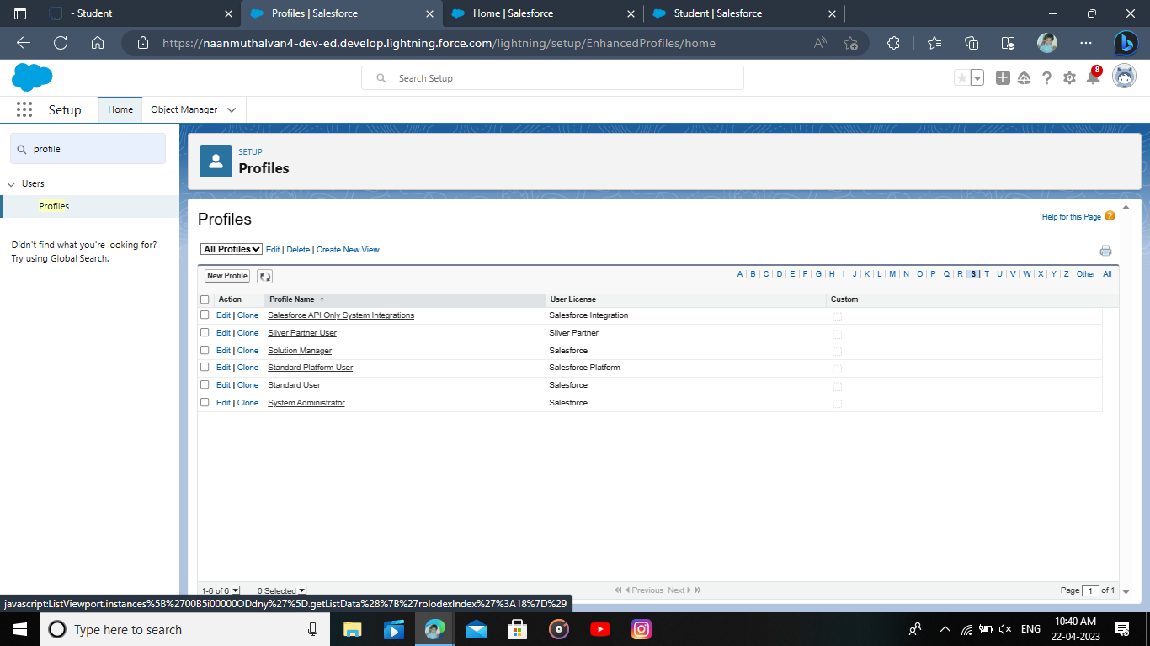
Milestone 5 : Profile
.
A Profile is group of settings and permissions that define what a user can do in salesforce . A profile controls “Object permissions, User permissions, Tab settings, App settings, Apex class access, visualforce page access, page layouts, Record Types, Login hours & Login IP ranges.

Slide 26
Milestone 6 : User

Slide 27
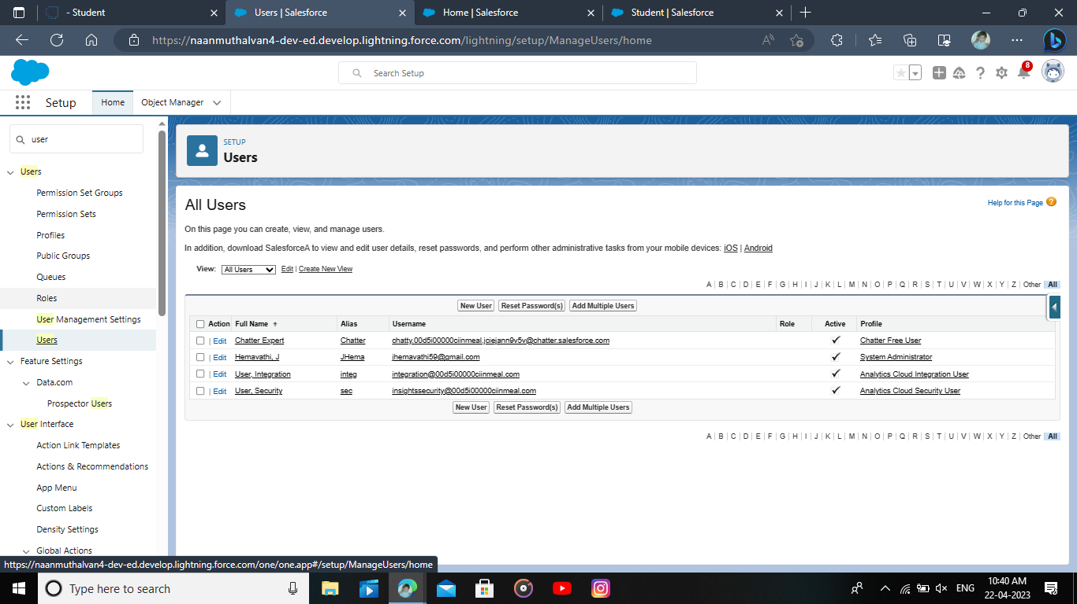
Milestone 6 : User
A User is anyone who logs in to salesforce. Users are employees at your company, such as sales rep, managers, and IT specialist, who need access to the company’s records. Every user in Salesforce has a user account. The user account identifies the user, and the user account settings determine what features and records the user can access.

Slide 28
Milestone 7 : Permission Sets

Slide 29
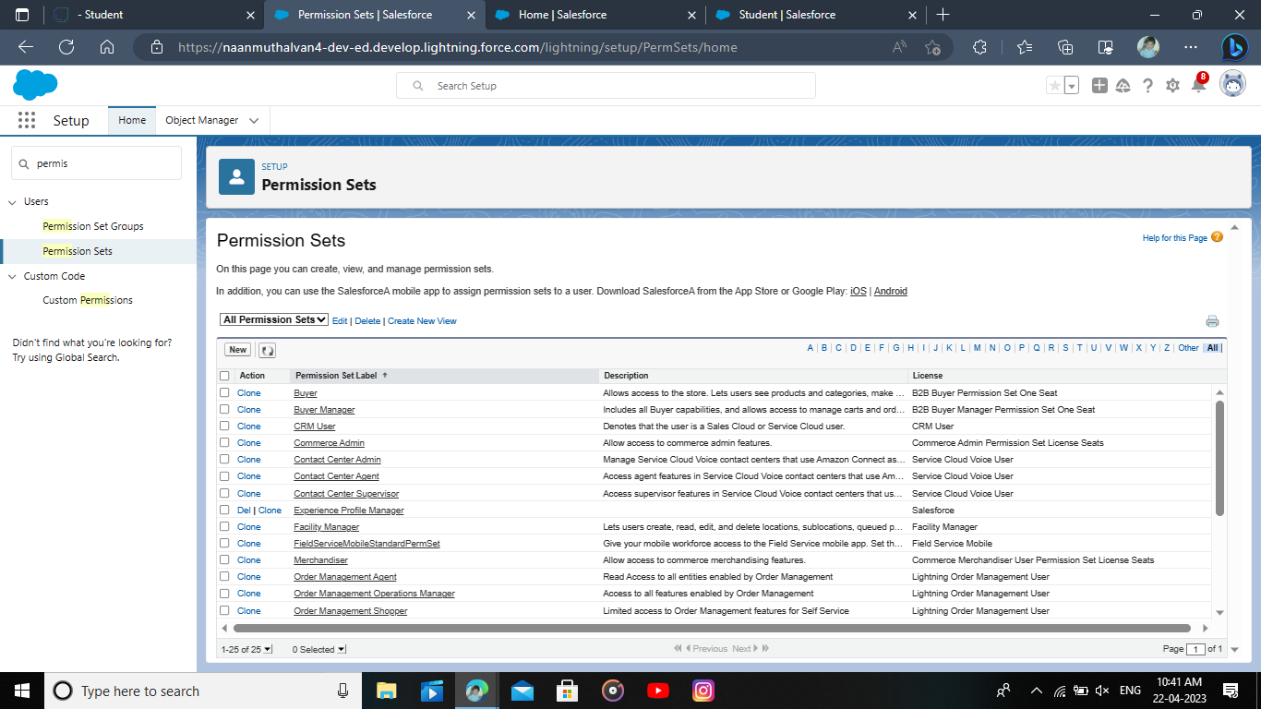
Milestone 7 : Permission sets
A permission set is a collection of settings and permissions that give users access to various tools and functions. Permission sets extend users' functional access without changing their profiles. Users can have only one profile but, depending on the Salesforce edition, they can have multiple permission sets.

Slide 30
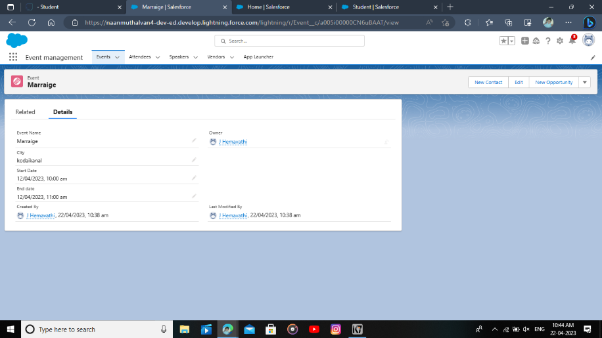
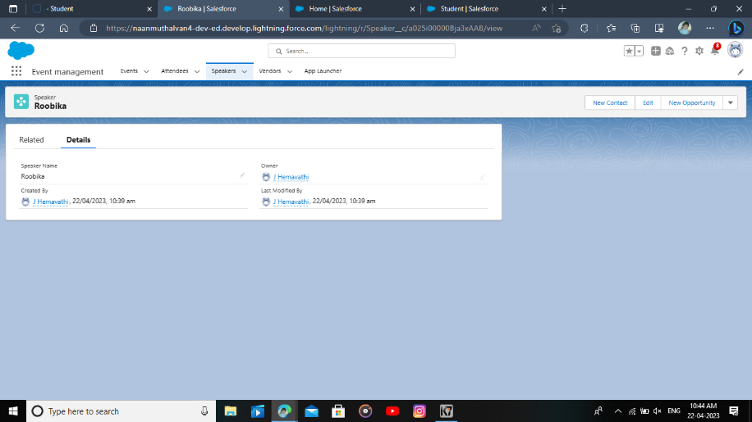
Milestone 8: Reports
Report of Event
Report of Attendee

Slide 31

Report of Speaker
Report of Vendor
A report is a list of records that meet the criteria you define. It's displayed in Salesforce in rows and columns, and can be filtered, grouped, or displayed in a graphical chart. Every report is stored in a folder. Folders can be public, hidden, or shared, and can be set to read-only or read/write.

Slide 32
Advantage of Event Management:
1. Easier Management
2. Save Time
3. Cut Costs
4. Increase Engagement
5. Improved Data Collection

Slide 33
Disadvantage of Event Management:
Unconventional work hours. ...
Time away from family and friends. ...
Experience requirements. ...
Job instability. ...
Multiple events at the same time. ...
High level of responsibility…

Slide 34
Application:
Event management is the application of project management to the creation and development of small and/or large-scale personal or corporate events such as festivals, conferences, ceremonies, weddings, formal parties, concerts, or conventions.

Slide 35
Conclusion:
Event Management System is user friendly and cost effective system, it is customized with activities related to event management life-cycle.
It provides a new edge to management industry. Solution Dot always keep your objectives and goals on top priority while developing any plan of work.

Slide 36
Future Scope of Event Management:
Events and festivities are the heart and soul of India. There are thousands of events held every year which are professionally managed. From corporate seminars to diplomatic talks, and from regional fairs to weddings, event management companies plan and organize events of all sorts.

